Slide 1



NASA INTERNATIONAL SPACE APPS CHALLENGE 2023
ARTEMIS II
AND
YOU!
PRESENTED BY
THE LUNAR VISIONARIES TEAM
7TH-8TH OCTOBER 2023

Slide 2
PROBLEM STATEMENT
Create A Short Video showcasing how Artemis II mission's development affects you and your community, no matter your location.

Slide 3
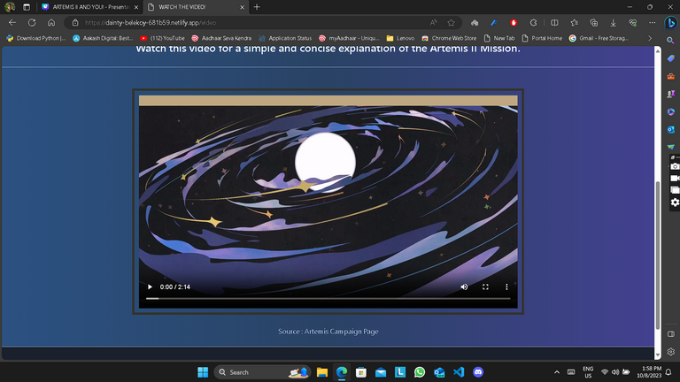
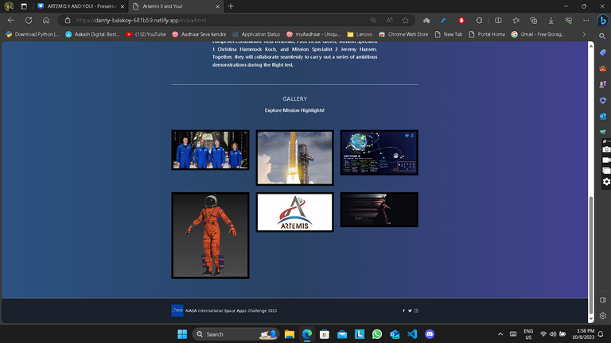
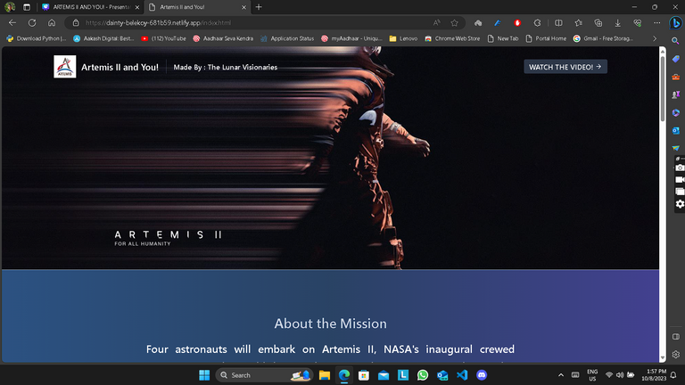
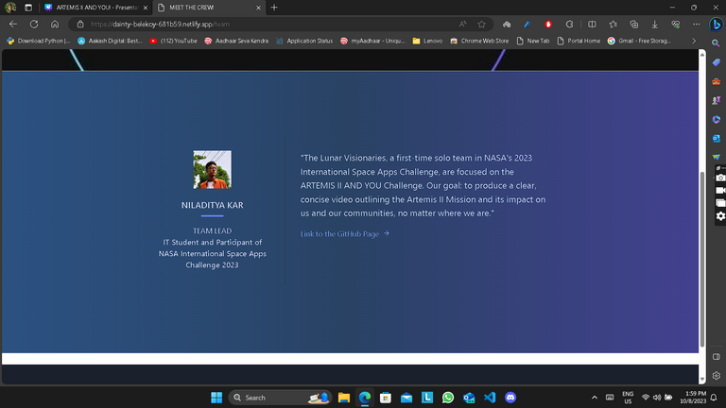
SOLUTION
SHORT VIDEO ON ARTEMIS II MISSION DEVELOPMENT.
A WEBSITE WITH EMBEDDED VIDEO AND MISSION DETAILS.

Slide 4
SCOPE OF THE PROJECT
OUR PROJECT AIMS TO RAISE AWARENESS AND INSTILL A SENSE OF BELONGING IN PEOPLE AS PART OF THE ARTEMIS GENERATION.
ANYONE WITH OUR SITE LINK CAN ACCESS OUR PROJECT AND WATCH THE VIDEO EXPLAINING THE MISSION.

Slide 5
MONETIZATION STRATEGY
AD REVENUE
Host this video on YouTube, earn money through the YouTube Partner Program by allowing ads to play on the video
PAID ACCESS
Charge viewers to access the video. This can be done through platforms like Vimeo On Demand or by setting up payment gateway on the website
BUILD AN AUDIENCE
Promote the video and website through social media, forums, blogs, and any other channels where the target audience hangs out.

Slide 6
BUSINESS MODEL CANVAS
Video content creators
Advertisers
Payment gateway providers
Video hosting and streaming
Content moderation
A platform for creators to share their content and gain visibility
High-quality streaming service for viewers
Personalized recommendations based on user preferences
Community engagement through comments, likes, shares, etc.
Customer support for any technical issues
Content creators looking for a platform to host their videos
Viewers looking for diverse and personalized content
KEY PARTNERS
KEY ACTIVITIES
VALUE PROPOSITIONS
CUSTOMER
RELATIONSHIPS
CUSTOMER SEGMENTS
Platform/website
User-generated content
The website itself
Social media platforms for promotion and user engagement
KEY RESOURCES
CHANNELS
Server and infrastructure costs
Content moderation and support staff
Marketing and advertising expenses
Advertising revenue
Premium subscriptions for ad-free viewing or additional features
COST STRUCTURES
REVENUE STREAMS

Slide 7
Resource Page
1 | GITHUB REPOSITORY: https://github.com/Niladitya-coder/artemis2-and-you.git
2 | PROJECT SITE: 1) https://niladitya-coder.github.io/artemis2-and-you/ 2 https://dainty-belekoy-681b59.netlify.app/
YOU CAN ACCESS OUR PROJECT SITE AND OUR CODE FROM HERE:

